Slide 1
ICT-LEARNFACTORY
Multi-User-Applikationen
objektorientiert realisieren
Access Control
08/16/26
Notes:
[Sources]
- Redesign follows the supplied ICT-LearnFactory Brand Guide (Aptos typography; Charcoal Flux #272726, Hyper Teal #45D9C7, Lumen Zest #D9EB12, Abyss Teal #29948C; geometric brand-mark pattern language).
- Slide content is preserved from the uploaded source presentation 08_Access-Control.odp.
[/Sources]

Slide 2
Handlungsnotwendige Kenntnisse
3.1 Kennt spezifische Elemente für die Umsetzung von Multi-User-fähigen Benutzerschnittstellen (z.B. Profil, unterschiedliche Benutzersichten, Berechtigungskonzept, usw.).
3.2 Kennt Möglichkeiten, ein mehrbenutzer-fähiges Rechtemanagement zu implementieren.
ICT-LEARNFACTORY
Access Control
Notes:
[Sources]
- Redesign follows the supplied ICT-LearnFactory Brand Guide (Aptos typography; Charcoal Flux #272726, Hyper Teal #45D9C7, Lumen Zest #D9EB12, Abyss Teal #29948C; geometric brand-mark pattern language).
- Slide content is preserved from the uploaded source presentation 08_Access-Control.odp.
[/Sources]

Slide 3
Ziele
Du kennst Gruppen, Rollen und Rechte und weisst für was sie gebraucht werden
Du kennst Möglichkeiten um Berechtigungen in .NET Core zu implementieren
ICT-LEARNFACTORY
Access Control
Notes:
[Sources]
- Redesign follows the supplied ICT-LearnFactory Brand Guide (Aptos typography; Charcoal Flux #272726, Hyper Teal #45D9C7, Lumen Zest #D9EB12, Abyss Teal #29948C; geometric brand-mark pattern language).
- Slide content is preserved from the uploaded source presentation 08_Access-Control.odp.
[/Sources]

Slide 4
Definition
Benutzer
Identität
Kann in einer oder mehreren Gruppen sein
Gruppe
Gruppierung mehrerer Benutzer mit gemeinsamen Merkmalen
Kann eine oder mehrere Rollen bekommen.
Rolle/Scope
Eine Sammlung von Rechten
Recht
Definiert ob und wie auf Ressourcen zugegriffen werden kann
ICT-LEARNFACTORY
Access Control
Notes:
[Sources]
- Redesign follows the supplied ICT-LearnFactory Brand Guide (Aptos typography; Charcoal Flux #272726, Hyper Teal #45D9C7, Lumen Zest #D9EB12, Abyss Teal #29948C; geometric brand-mark pattern language).
- Slide content is preserved from the uploaded source presentation 08_Access-Control.odp.
[/Sources]

Slide 5
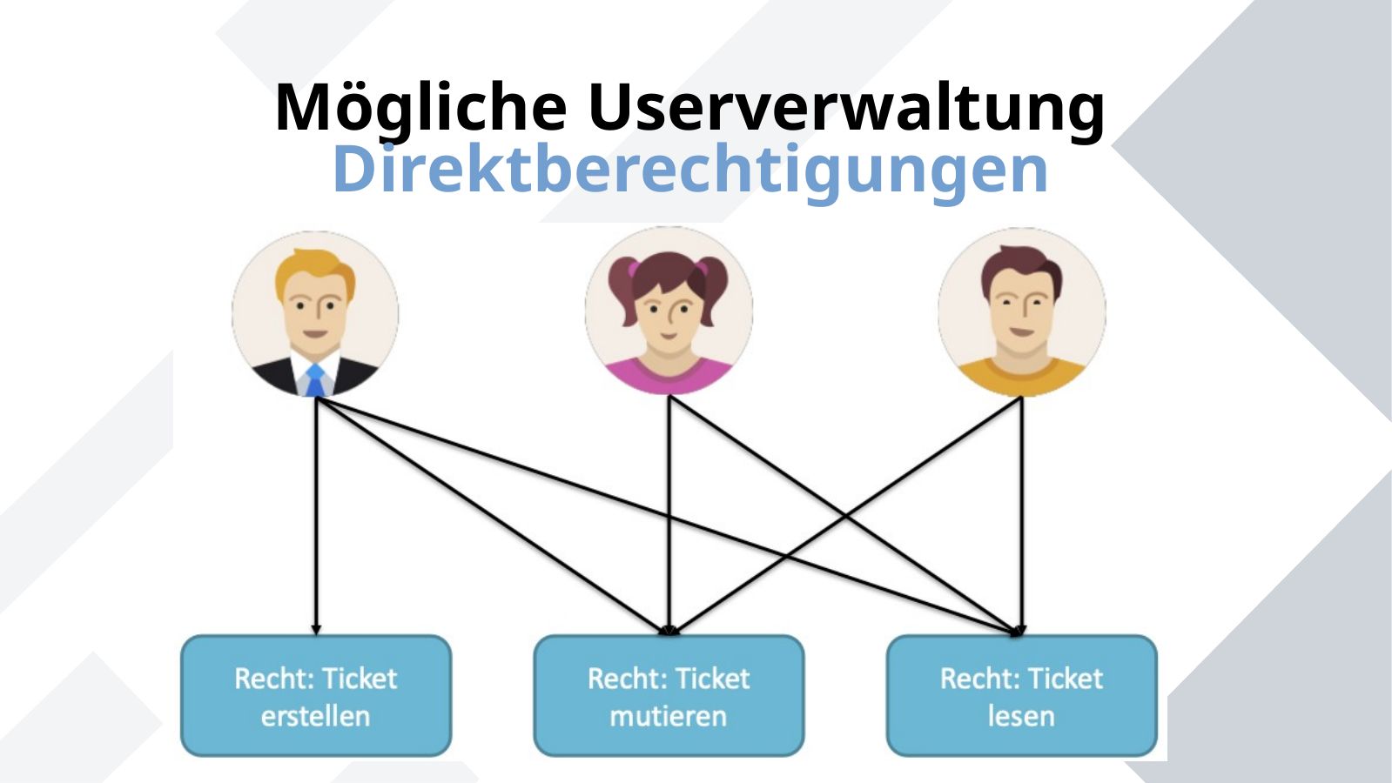
Mögliche Userverwaltung
Direktberechtigungen
ICT-LEARNFACTORY
Access Control
Notes:
[Sources]
- Redesign follows the supplied ICT-LearnFactory Brand Guide (Aptos typography; Charcoal Flux #272726, Hyper Teal #45D9C7, Lumen Zest #D9EB12, Abyss Teal #29948C; geometric brand-mark pattern language).
- Slide content is preserved from the uploaded source presentation 08_Access-Control.odp.
[/Sources]

Slide 6
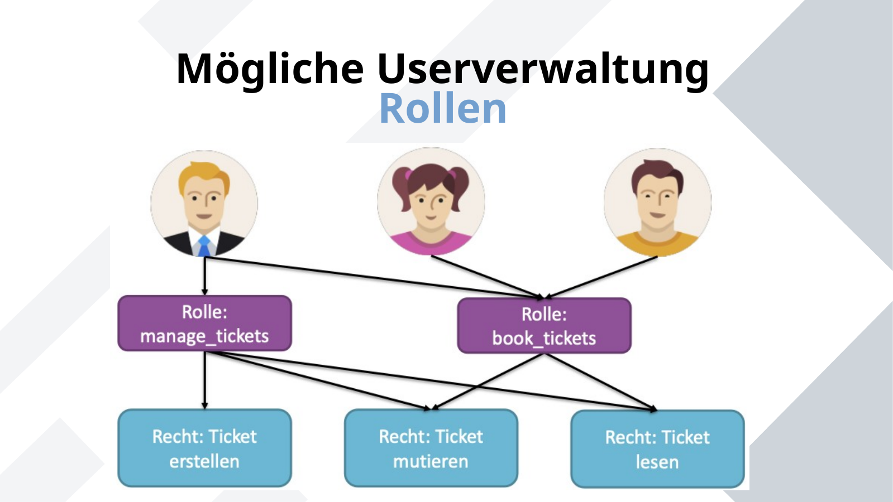
Mögliche Userverwaltung
Rollen
ICT-LEARNFACTORY
Access Control
Notes:
[Sources]
- Redesign follows the supplied ICT-LearnFactory Brand Guide (Aptos typography; Charcoal Flux #272726, Hyper Teal #45D9C7, Lumen Zest #D9EB12, Abyss Teal #29948C; geometric brand-mark pattern language).
- Slide content is preserved from the uploaded source presentation 08_Access-Control.odp.
[/Sources]

Slide 7
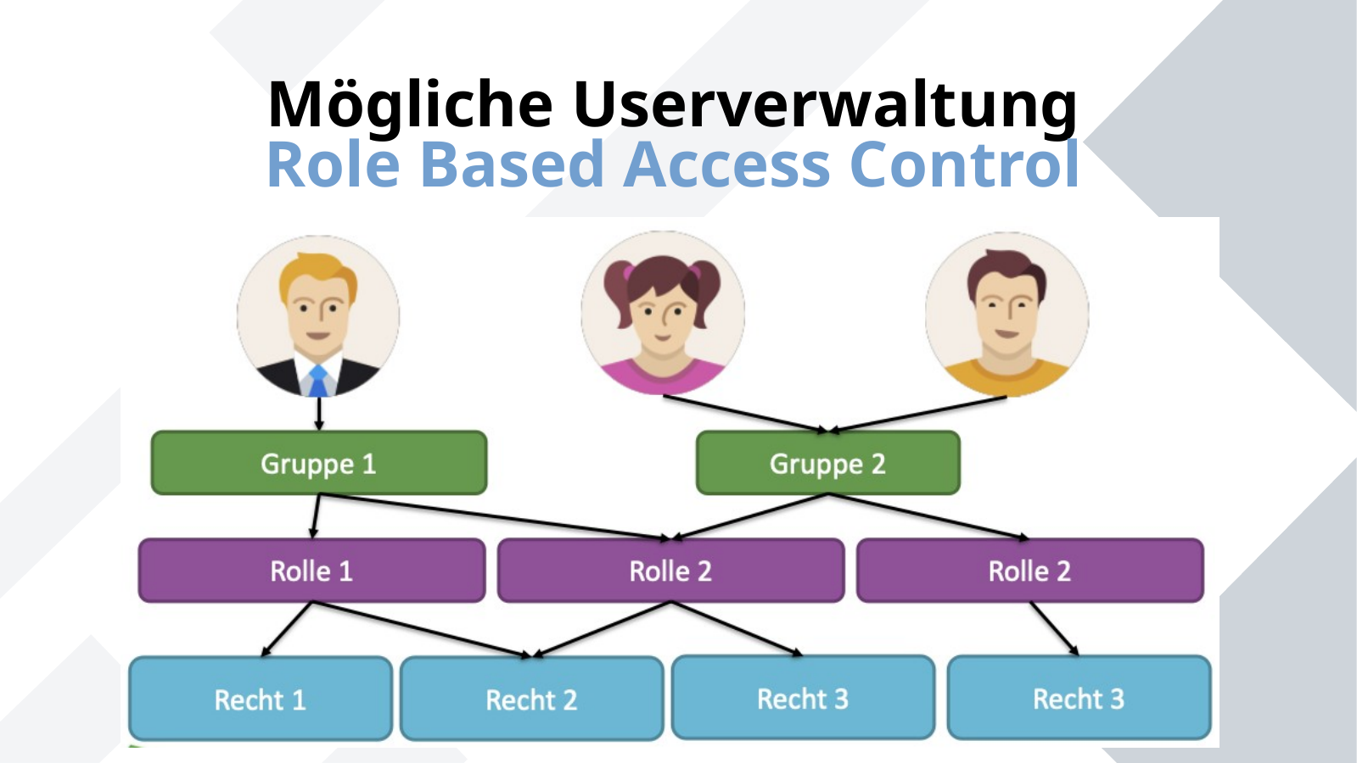
Mögliche Userverwaltung
Role Based Access Control
ICT-LEARNFACTORY
Access Control
Notes:
[Sources]
- Redesign follows the supplied ICT-LearnFactory Brand Guide (Aptos typography; Charcoal Flux #272726, Hyper Teal #45D9C7, Lumen Zest #D9EB12, Abyss Teal #29948C; geometric brand-mark pattern language).
- Slide content is preserved from the uploaded source presentation 08_Access-Control.odp.
[/Sources]

Slide 8
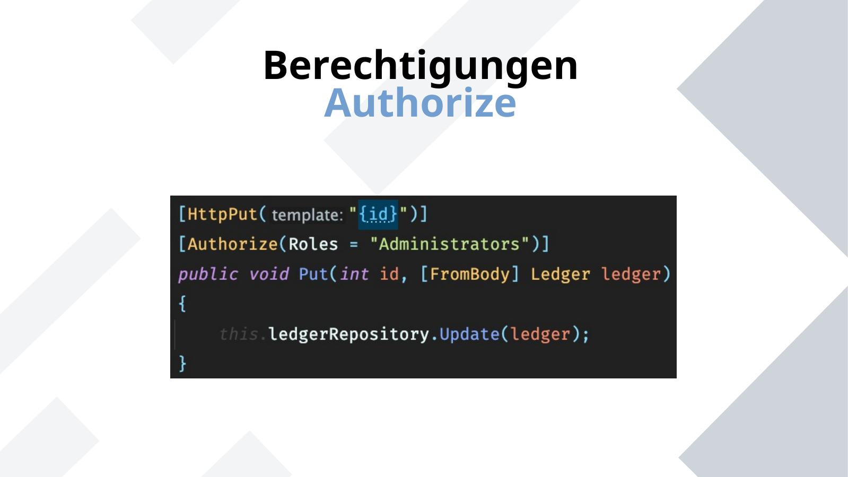
Berechtigungen
Authorize
ICT-LEARNFACTORY
Access Control
Notes:
[Sources]
- Redesign follows the supplied ICT-LearnFactory Brand Guide (Aptos typography; Charcoal Flux #272726, Hyper Teal #45D9C7, Lumen Zest #D9EB12, Abyss Teal #29948C; geometric brand-mark pattern language).
- Slide content is preserved from the uploaded source presentation 08_Access-Control.odp.
[/Sources]

Slide 9
Fragen?
ICT-LEARNFACTORY
Access Control
Notes:
[Sources]
- Redesign follows the supplied ICT-LearnFactory Brand Guide (Aptos typography; Charcoal Flux #272726, Hyper Teal #45D9C7, Lumen Zest #D9EB12, Abyss Teal #29948C; geometric brand-mark pattern language).
- Slide content is preserved from the uploaded source presentation 08_Access-Control.odp.
[/Sources]

